Slide 1
Drug designer database
Carlos Dominguez(Developer, Tester, everything…) Product Owner: Dr. Luis Arroyo

Slide 2
Presentation
What’s my project about?

Slide 3
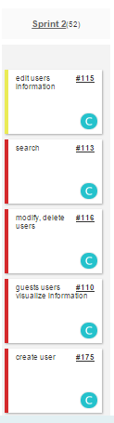
Stories in spring 2
Estimated
Actual
8 points
8 points
16 Points
16 points
16 Points
16 points
16 Points
0 points
8 Points
8 points
48 ---- = 1.2 40
Velocity =

Slide 4
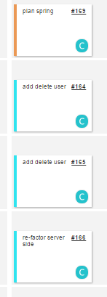
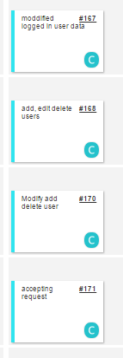
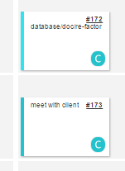
Mingle Daily Scrum

Slide 5
Documents
Feasibility Study & Project Plan: not need to changed
Requirement: not need to changed
Design: sequence diagram added
User Manual : features added
Installation and maintenance: added

Slide 6
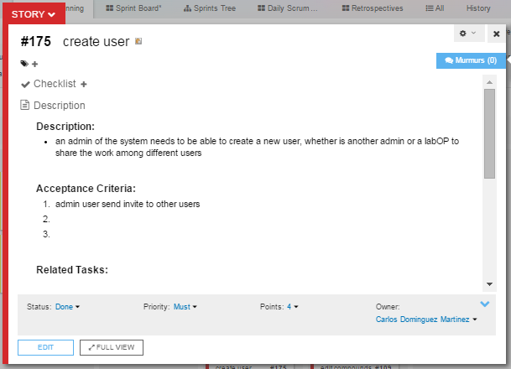
Invite Use Case

Slide 7
Use Case
Name: 175_createUser
Participating actor: admin user
Entry condition: User is logged in the system User is in their account home page. User has admin rights
Exit condition: User invite is sent
Event flow: User click on the Manage User option on the right side menu System goes to the controller which return to the user management page User enter the email of the user to be invited User clicks the invite button. System sends an email to the user and adds the invitation to the database to later be recognized

Slide 8
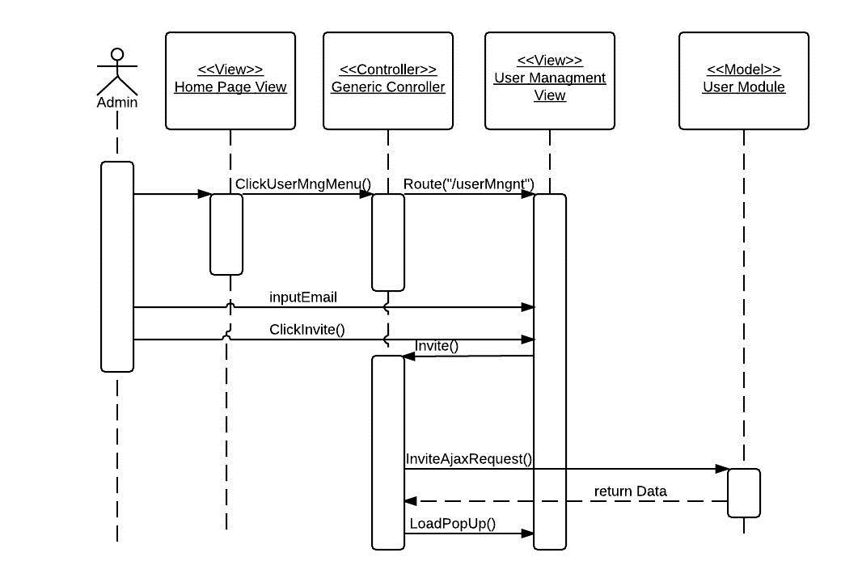
Invite new user sequence Diagram
Login()

Slide 9
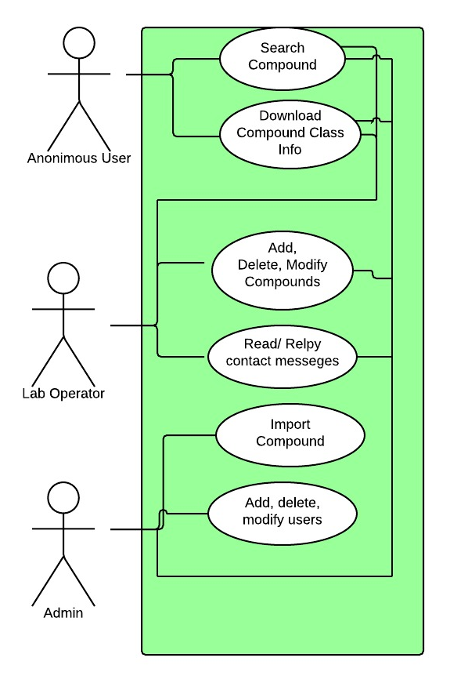
Use Case Diagram

Slide 10
User Manual
Login feature explained for admins.
Add delete logged in user feature explained
Add, delete, modify users for admins explained.

Slide 11
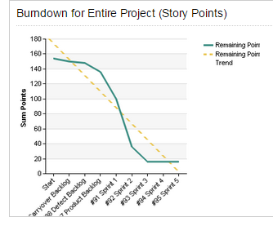
BurnDown Chart
All story points were finished

Slide 12
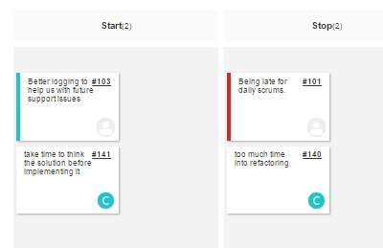
Retrospectives
Start:
need to write in words what I am going to do before doing it
Stop
need to spend less time into re-factoring and more time into coding other features

Slide 13
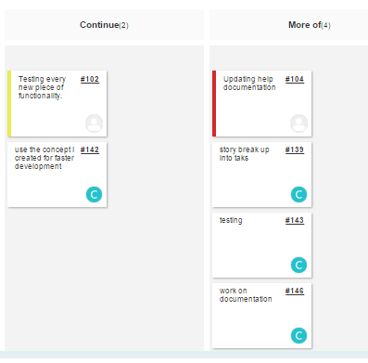
Retrospective
Continue
need to continue using the concept where there is a universal controller and add on on to it This serves for organization and structural purposes
More of
- breaking the story points into smaller tasks
- testing
Documentation

Slide 14
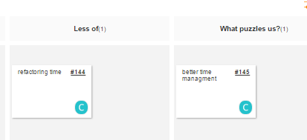
Retrospective
Less of: time in refactoring
What puzzles us? need to implement better time stimation

Slide 15
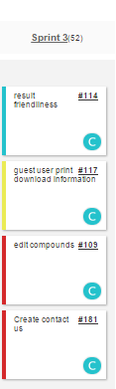
Current Sprint

Slide 16
DEMO

